Slide 1
The Structural Simulation Toolkit
SAND2019-13495 C
The SST and GPGPU-Sim Teams (Sandia, Purdue)

Slide 2
Welcome!
Part 1: Introduction to SST 8:45 - 10:15
SST Overview
Demos: Running a simple simulation; Enabling statistics; Running in parallel
SST Element Libraries: A tour
Break 10:15 - 10:45
SST Element Libraries: A tour
Demos: L2 Cache; Backing store; Adding processors; Adding Memory; Node modeling
Lunch 12:00 - 1:30
Part 2: GPGPU-Sim 1:30 – 2:30
GPGPU-Sim Overview & New Features
Part 3: The SST/GPGPU-Sim Integration 2:30 - 3:00
Break 3:00 - 3:30
GPGPU-Sim Exercises 3:30 - 5:00

Slide 3


Instructors
Clay Hughes chughes@sandia.gov
Roland Green rgreen.dev@gmail.com

Slide 4
References
Websites
http://www.sst-simulator.org/
https://github.com/sstsimulator
Configuration File Format:
http://sst-simulator.org/SSTPages/SSTUserPythonFileFormat/
Doxygen Documentation:
http://sst-simulator.org/SSTDoxygen/9.0.0_docs/html/
Developer FAQ:
http://sst-simulator.org/SSTPages/SSTTopDocDeveloperInfo/
Building SST
http://sst-simulator.org/SSTPages/SSTBuildAndInstall9dot0dot0SeriesQuickStart/
http://sst-simulator.org/SSTPages/SSTBuildAndInstall9dot0dot0SeriesDetailedBuildInstructions/

Slide 5

So many simulators, so little interoperability
Already a rich selection of open-source simulators
But not a solid ecosystem for modeling systems
Tightly-entangled components make modifications complex
E.g., assumptions about caching or address mapping pervasive
Most simulator integrations are ad-hoc, not lasting
Significant performance problems with tying many simulators together
Wants:
Enable “mix-and-match” of existing models to create custom systems
Encourage disentangled models with clean interfaces for swapping functionality
Bricks not buildings
Low effort, high performance parallel simulation
Continuous path from low-fidelity/fast modeling to high-fidelity/slow models

Slide 6



The Structural Simulation Toolkit
Goals
Create a standard architectural simulation framework for HPC*
Ability to evaluate future systems on DOE/DOD workloads
Use supercomputers to design supercomputers
Status
Parallel framework (SST Core)
Integrated libraries of components (Elements)
Current Release (9.0)
https://sst-simulator.org
https://github/sstsimulator
Technical Approach
Parallel Discrete Event core
With conservative optimization over MPI/Threads
Interoperability
Node and system-scale models
Multi-scale
Detailed (~cycle) and simple models that interoperate
Open
Open Core, non-viral, modular
Consortium
“Best of Breed” simulation suite
Combine Lab, Academic & Industry

Slide 7
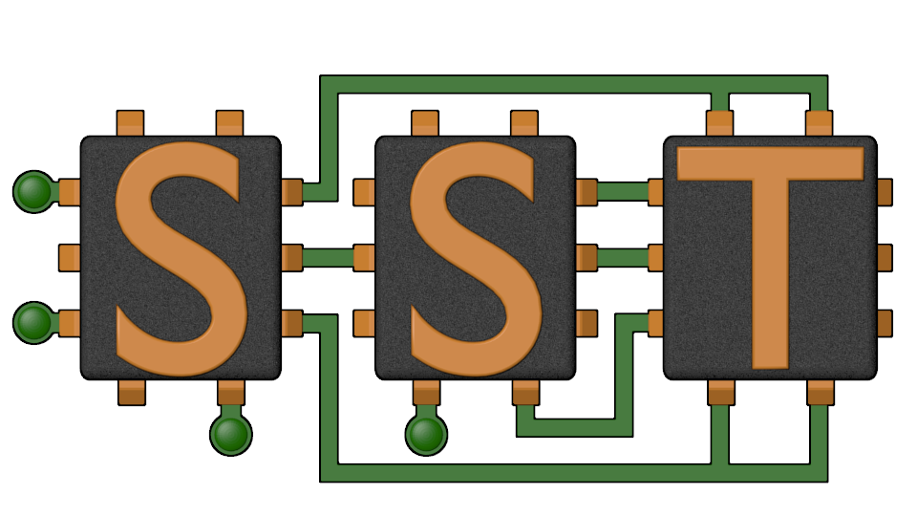
The SST Approach
Parallel Discrete-Event Simulator Framework (SST Core)
Flexible framework enables multitude of custom “simulators”
Demonstrated scaling to over 512 processors running a million+ components
Comes with many built-in simulation models (SST Elements)
Processors, memories, networks
Open API
Easily extensible with new models
Modular framework
Open-source core
Time-scale independent core
Handles Micro-, Meso-, Macro-scale simulations
C++, Python

Slide 8
SST Architecture
SST Core framework
The backbone of simulation
Provides utilities and interfaces for simulation components (models)
Clocks, event exchange, statistics and parameter management, parallelism support, etc.
SST Element libraries
Libraries of components that perform the actual simulation
Elements include processors, memory, network, etc.
Includes many existing simulators: DRAMSim2, Spike, HMCSim, Ramulator, etc.
Component
Component
Component
Component
Integration Services
SST Core
MPI and C++ Threads

Slide 9
Running a simulation and code orientation
High-Level View

Slide 10
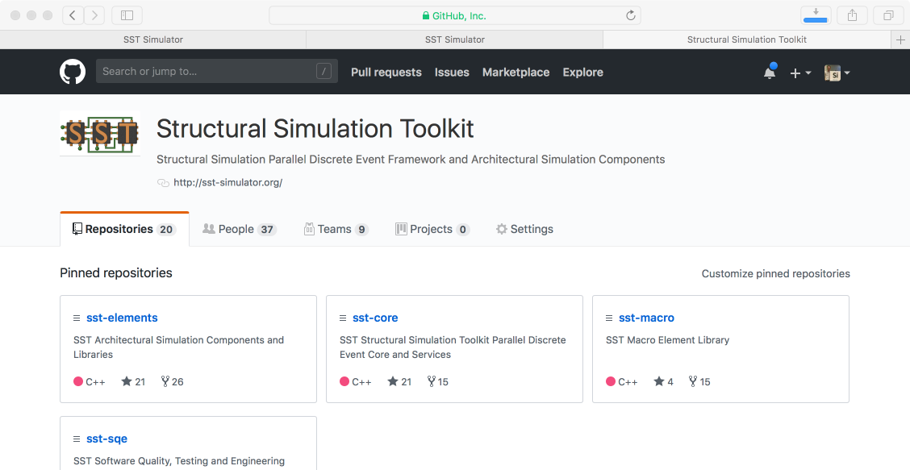
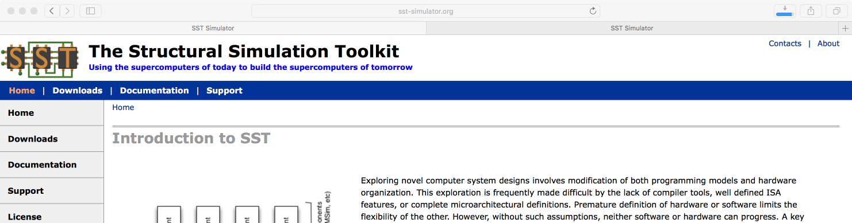
Getting and Installing SST
http://www.sst-simulator.org
Current release source download
Detailed build instructions including dependencies for Linux & Mac
Archived tutorial materials
https://github.com/sstsimulator
Source code checkout
Master branch – has passed testing
Devel branch – has passed basic testing

Slide 11
Building Blocks
SST simulations are comprised of components connected by links
Every link has a minimum (non-zero) latency
Components define ports which are valid connection points for a link
Components communicate by sending events over the links
Components can use subcomponents and modules for customizable functionality
Component
Core
Link
Latency: 1ns
Component
Cache
Link
Latency: 2ns
Component
NoC Router
Event
Load
Event
Data
Element Library
A collection of components, subcomponents, and/or modules
SubComponent
Prefetcher
Link
Latency: 4ns
Component
Core
Link
Latency: 1ns
Component
Cache
Link
Latency: 2ns
Component
NoC Router

Slide 12

SST Code Structure
SST Core and SST Elements are compiled separately
Element libraries register with the core
External elements (not part of SST Elements) can also be registered with the core
Example at github.com/sstsimulator/sst-external-element
Core maintains a database of registered libraries
Can query database with sst-info utility
Source code for core:
sst-core/src/sst/core/
Source code for elements
sst-elements/src /sst/elements/
Most elements have a tests/ directory
Often a good starting point for example configurations
Component
Component
Component
Component
Integration Services
SST Core
MPI and C++ Threads

Slide 13
Simulating with SST
We’ll walk through how to configure a simulation and then run it
Available at: https://github.com/sstsimulator/sst-tutorials/tree/master/iiswc2019
( github → sstsimulator → sst-tutorials → iiswc2019 )
Element libraries in our example simulation
Miranda - Simple core model that runs generated instruction streams
Generators produce memory access patterns (SubComponents)
memHierarchy – Various cache/memory system related subcomponents and modules
Cache (Component) with coherence protocol SubComponent
Memory Controller (Component) that loads a memory timing model (SubComponent)
Gen
Core
L1 Cache
MemCtrl
Mem
2.4GHz, issue 2 accesses/cycle
Stream triad generator
Three 1K element arrays A,B,C
Compute C[i] = A[i] + 2*B[i]
→ 2K reads & 1K writes
2KB, 4-way set associative
2.4GHz, 2 cycle access
64B cache lines
LRU replacement MESI coherence protocol
50ns constant access latency
1GB capacity

Slide 14
Configuration File: Global SST parameters
Set any global simulation parameters
End simulation at 100ms if it hasn’t ended already
Other options
Most are also available as command line arguments to SST
sst.setProgramOption(“stopAtCycle”, “100ms”)
SST Python API
User-defined string
SST argument
Option | Definition
debug-file | File to print debug output to
heartbeat-period | If set, SST will print a heartbeat message at the specified period
timebase | Units of simulation. Default is picoseconds which enables 2/3 of a year.
partitioner | Partitioner to use for parallel execution
output-partition | File to print partition to

Slide 15
Configuration File: Declare components and links
Components: sst.Component(“name”, “type”)
Links: sst.Link(“name”)
core = sst.Component(“core”, “miranda.BaseCPU”)
cache = sst.Component(“L1”, “memHierarchy.Cache”)
mctrl = sst.Component(“memctrl”, “memHierarchy.MemController”)
Gen
Core
Component name
Component library.type
Cache
link0 = sst.Link(“core_to_cache”)
link1 = sst.Link(”cache_to_memory”)
MemCtrl
SST Python API
User-defined string
SST argument
Mem
Link name

Slide 16

Configuration File: Configure the components
Parameters: addParams({ “parameter” : “value”, … })
SubComponents: setSubComponent(“slotname”, “type”)
Recall: SubComponent is a swappable piece of functionality
core.addParams({ “clock” : “2.4GHz” })
Gen
Core
Cache
gen = core.setSubComponent(“generator”, “miranda.STREAMBenchGenerator”)
memory = mctrl.setSubComponent(“backend”, “memHierarchy.simpleMem”)
MemCtrl
How do I know what the options are? Or even what elements I can pick from?
Mem
SST Python API
User-defined string
SST argument

Slide 17
SSTInfo: Getting component info
sst-info: utility to query element libraries
Optionally filter for a specific library and/or component
$ sst-info miranda.BaseCPU
PROCESSED 1 .so (SST ELEMENT) FILES FOUND IN DIRECTORY(s) /home/sst/build/sst-elements/lib/…
Filtering output on Element = “miranda.BaseCPU”
================================================================================
ELEMENT 0 = miranda ()
Num Components = 1
Component 0: BaseCPU
CATEGORY: PROCESSOR COMPONENT
NUM STATISTICS = 17
…
NUM PORTS = 2
PORT 0 = cache_link (Link to Memory Controller)
…
NUM SUBCOMPONENT SLOTS = 2
SUB COMPONENT SLOT 0 = generator (What address generator to load) [SST::Miranda::RequestGenerator]
…
NUM PARAMETERS = 12
PARAMETER 0 = clock (Clock for the base CPU) [2GHz]
…
Port name
Definition
SubComponent API
Definition
Slot name
“REQUIRED” or default value
Parameter
Definition

Slide 18
Configuration File: Connecting the components
Declared links and components a couple slides ago…
Connect components: connect(endpoint1, endpoint2)
Where endpoint is: (component, port, latency)
link0 = sst.Link(“core_to_cache”)
link1 = sst.Link(“cache_to_memory”)
core = …
cache = …
mctrl = …
Gen
Core
Cache
link0.connect(
(core, “cache_link”, “100ps”),
(cache, “high_network_0”, “100ps”) )
link1.connect(
(cache, “low_network_0”, “100ps”),
(mctrl, “direct_link”, “100ps”) )
Endpoint 1
MemCtrl
Endpoint 2
Mem

Slide 19
Running SST
Usage: sst [options] configFile.py
Common options:
-v | --verbose | Print information about core runtime
--debug-file <filename> | Send debugging output to specified file (default: sst_output)
--partitioner <zoltan | self | simple | rrobin | linear | lib.partitioner.name> | Specify the partitioning mechanism for parallel runs
-n | --num_threads <num> | Specify number of threads per rank
--model-options “<args>” | Command line arguments to send to the Python configuration file
--output-partition <filename> | Write partitioning information to <filename>
--output-dot <filename> --output-xml <filename> --output-json <filename> | Output the configuration graph in various formats to <filename>
Notes:
Is this still up to date?

Slide 20
Running a simulation
Launch simulation
Output
We probably want more information about what happened though
Enable statistics!
$ sst demo_1.py
Simulation is complete, simulated time: 6.66491 us

Slide 21
Enabling statistics
Most Components and SubComponents define statistics
Enable statistics in the configuration file
enableAllStatisticsForAllComponents()
enableAllStatisticsForComponentType(type)
enableAllStatisticsForComponentName(name)
setStatisticLoadLevel(level)
Configure output
setStatisticOutput(“sst.output_type”)
setStatisticOutputOptions({“option” : “value”, })
$ sst-info memHierarchy.Cache
…
NUM STATISTICS = 51
STATISTIC 0 = CacheHits [Total number of cache hits] (count) Enable Level = 1
STATISTIC 1 = latency_GetS_hit [Latency for read hits] (cycles) Enable level = 1
enableStatisticForComponentName(name, stat)
enableStatisticForComponentType(type, stat)

Slide 22
Running with statistics enabled
Let’s enable statistics for all components
Caches have A LOT of statistics so send the output to a CSV file
Other options: sst.statoutputX where X=
console
json
txt
hdf5
sst.setStatisticOutput(“sst.statoutputcsv”)
sst.setStatisticOutputOptions({ “filepath” : “stats.csv” })
sst.setStatisticLoadLevel(5)
sst.enableAllStatisticsForAllComponents()

Slide 23
Running a Simulation – Add Statistics
Copy configuration
Add statistics to new configuration
Launch simulation
Take a minute to look at the statistics
Can you calculate the L1 memory bandwidth?
$ cp demo_1.py demo_2.py
What should you add?
$ sst demo_2.py

Slide 24
SST in parallel
SST was designed from the ground up to enable scalable, parallel simulations
Components distributed among MPI ranks/threads
Link latency controls synchronization rate
MPI Rank 0
Comp0
Comp2
Comp4
Comp6
Comp1
Comp3
Comp5
Comp7
# Two ranks
$ mpirun –np 2 sst demo1.py
# Two threads
$ sst –n 2 demo1.py
# Two ranks with two threads each
# This will give a warning since we only
# have 3 components across 4 ranks/threads
$ mpirun –np 2 sst –n 2 demo1.py
Same configuration file
MPI Rank 0
MPI Rank 1
MPI Rank 2
MPI Rank 3
Comp0
Comp2
Comp4
Comp6
Comp1
Comp3
Comp5
Comp7
Notes:
Links handle serialization

Slide 25
SST Elements: A Tour

Slide 26

SST Element Libraries
Elements are libraries of related components
Elements must be registered with the SST core
Tells SST where to find this set of components
Includes information on parameters and statistics for each component
SST provides a set of element libraries
Processor, network, memory, etc.
Tested for interoperability within and across libraries
Many are compatible with external “components” such as Ramulator and Spike
See www.sst-simulator.org for more information
You can also register your own elements

Slide 27
SST 9.0 Elements
Processors
Ariel – PIN-based
Juno – simple ISA processor
Miranda – pattern generator
Prospero – trace execution
GeNSA – Spiking temporal processing unit
Memory Subsystem
cacheTracer – cache tracing
Cassini – cache prefetchers
CramSim – DDR, HBM
MemHierarchy – caches, directory, memory
Messier - NVM
Samba – TLB
VaultSimC – vaulted stacked memory
Network drivers
Ember – communication patterns
Firefly – communication protocols
Hermes – MPI-like driver interface
Zodiac – trace based driver
Thornhill – memory models for Ember sims
Networks/NoCs
Merlin – flexible network modeling
Kingsley – mesh NoC
Shogun – crossbar NoC
Others
sst-macro – network drivers/network
scheduler – job scheduling
simpleSimulation – “car wash” example
simpleElementExample – many examples
sst-external-element – example element

Slide 28
Juno: Simple instruction processor
Executes a program written in simple “assembly”
32-bit wide instructions with 8 bit op codes
64-bit integer operations
ADD, SUB, DIV, MUL,
AND, OR, XOR, NOT
Jump by register value (JGT-Zero, JLZ-Zero, J-Zero)
Jump up to16 bits in either direction from current PC
Up to 253 user registers
r0 = PC
r1 = data start register
Memory
Juno
Load/Store Unit
Instruction Manager
Register File
Processor
Memory
Network/NoC
Network driver
Other

Slide 29
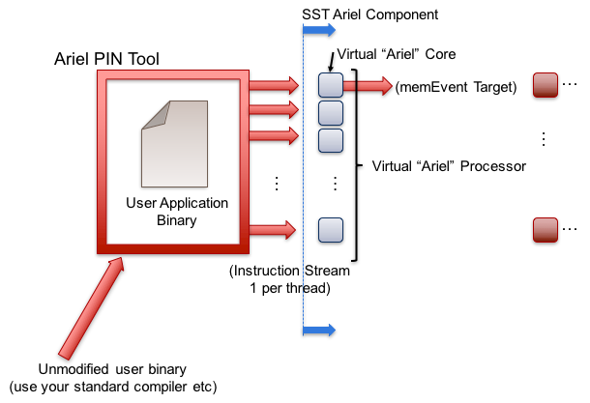

Ariel: PIN-based processor
Lightweight processor core model
Uses Intel’s PIN tools and XED decoders to analyze binaries
Runs x86, x86-64, SSE/AVX, etc. binaries
Supports fixed thread count parallelism (OpenMP, Qthreads, etc.)
Passes instructions to virtual core in SST
GPGPU-Sim Integration
Processor
Memory
Network/NoC
Network driver
Other

Slide 30
Ariel: Details
Pintool communicates with Ariel via shared memory IPC
Per-thread FIFO of instructions from pintool to Ariel’s virtual cores
Backpressure on FIFO halts the binary’s execution
Ariel’s virtual cores
Memory instruction oriented: execute memory instructions; other ins. single cycle no-ops
Clocked: Reads instruction stream in chunks but processes on clock
Does not maintain dependence order or register locations
Can map virtual-to-physical addresses internally or use external component
Key parameters
Ops issued/cycle
Load/store queue size
Uses SST simpleMem interface
Generates SimpleMemRequests
Compatible with memHierarchy
Processor
Memory
Network/NoC
Network driver
Other

Slide 31
Ariel: The Tradeoff
Pros:
Faster than more complex/pipeline models
Reasonable approximation for studies on memory system performance
Especially for heavily memory-bound applications
Reasonable model of thread interactions
Cons
Non-deterministic results
Interactions between pintool, threads, etc.
Variation is low (O(1%))
Not compatible with non-x86 binaries
Reliant on Pin 2.14
Currently working towards enabling Ariel to be used with other drivers
Processor
Memory
Network/NoC
Network driver
Other

Slide 32
Prospero: Trace-based processor
Trace-based processor model
Like Ariel, memory instruction oriented
Reads memory ops from a file and passes to the simulated memory system
“Single core” but can use multiple trace files to emulate threaded or MPI applications
Supports arbitrary length reads to account for variable vector widths
Performs “first touch” virtual to physical mapping
Comes with Prospero Trace Tool to generate traces
Or can generate your own and translate to Prospero’s format
Processor
Memory
Network/NoC
Network driver
Other

Slide 33
Prospero: The Tradeoff
Pros
Faster than Ariel*
Provided you can get a trace
Cons
Traces can be very large
Requires good I/O system to store and read the trace
Traces are less flexible than actual execution
Capture a single execution stream using a single application input
Processor
Memory
Network/NoC
Network driver
Other

Slide 34
Miranda: Pattern-based processor
Extremely light-weight processor model
Generates memory address patterns
Supports request dependencies
Library patterns
Strided accesses (single stream)
Forward and reverse strides
Random accesses
GUPS
STREAM benchmark
In-order & out-of-order CPU
3D stencil
Sparse matrix vector multiply (SpMV)
Copy (~array copy)
Stake interface to the Spike RiscV simulator
Processor
Memory
Network/NoC
Network driver
Other

Slide 35
Miranda: The tradeoffs
Pros
Very lightweight – no binary, no trace
Good for applications whose address patterns are predictable
e.g., not much pointer-chasing
Models instruction dependences
Cons
Need a generator for the memory pattern of interest
Requires a good understanding of the pattern
Processor
Memory
Network/NoC
Network driver
Other

Slide 36
MemHierarchy: Memory system
Collection of interoperable memory system elements
Caches
Directories
Memory controllers
Interfaces to memory models (DDR, HBM, HMC, NVM, etc.)
Scratchpads
NoC (network-on-chip) interfaces
Buses
Components are cycle-accurate/cycle-level
Capable of modeling modern cache and memory subsystems
Memory
Processor
Network/NoC
Network driver
Other

Slide 37
MemHierarchy: Cache modeling
Highly configurable
Arbitrary hierarchy depth, flexible topologies
Cache inclusivity, coherence, private/shared, etc. configurable
Single- and multi-socket configurations
Prefetch via Cassini element library
Data movement
Components support direct, bus, and on-chip network (NoC) communication
Event types: read/write, atomics, LLSC, noncacheable, custom memory, etc.
Memory
Processor
Network/NoC
Network driver
Other

Slide 38
MemHierarchy: Memory modeling
Interface to memory is the MemController
MemControllers implement backends
Timing model for memory controller with a link to memory
Timing model for memory controller and memory
Interface to another component(s) that does the memory controller/memory timing
In this case just translates request formats
Wrapper for an external/non-native-SST component
Ramulator, DRAMSim2, etc.
Support custom memory instructions
Including ability to do cache shootdowns for coherence maintenance
Memory
Processor
Network/NoC
Network driver
Other

Slide 39
MemHierarchy: Memory modeling
Memory controller
Manages data values if needed (backing store)
Facilitates custom memory commands
Including cache shootdowns for coherence maintenance
Passes events to memory backend subcomponent
Backend: the “real” memory controller and/or memory
Implementations
Memory controller and model itself
Memory controller with interface to a memory component
Interface to another memory controller/memory component
Wrapper to an external simulator
Memory Controller
Backing store
Custom command handler
Backend
To memory component (optional)
Memory
Processor
Network/NoC
Network driver
Other

Slide 40
MemHierarchy: SST 9.0 backends
Memory (external)
CramSim (DDR, HBM)
DRAMSim2 (DDR)
PagedMulti – 2-level memory variant
FlashDIMMSim (FLASH)
HMCSim/GoblinHMC (HMC)
HBMDRAMSim2 (HBM)
HBMPagedMulti – 2-level memory variant
Messier (NVRAM)
Ramulator (DDR, HBM, HMC)
SimpleDRAM (DDR)
SimpleMem (constant latency)
TimingDRAM (DDR)
VaultSimC (HMC-like)
Plus a few that can be used with other backends to reorder requests, add latency, etc.
Memory
Processor
Network/NoC
Network driver
Other

Slide 41
Running a Simulation – Add Components, L2 Cache
Copy configuration
Add an L2 cache between L1 and memory to new configuration
What parameters are available for an L2 cache?
What are appropriate values for the parameters?
Launch simulation
How did this affect your overall simulated time?
How did this affect traffic to and from your backing store?
$ cp demo_2.py demo_3.py
What should you add?
$ sst demo_3.py

Slide 42
Running a Simulation – Switch Components, Timing DRAM
Copy configuration
Switch the simpleMem subcomponent for timingDRAM
Launch simulation
How do your results differ from the run with simpleMem?
$ cp demo_3.py demo_4.py
What should you change? Remember that sst-info is your pal!
$ sst demo_4.py

Slide 43
Merlin: Network simulator
Low-level networking components that can be used to simulate high-speed networks (machine level) or on-chip networks
Capabilities
High radix router model (hr_router)
Topologies – mesh, n-dim tori, fat-tree, dragonfly
Many ways to drive a network
Simple traffic generation models
Nearest neighbor, uniform, uniform w/ hotspot, normal, binomial
MemHierarchy
Lightweight network endpoint models (Ember – coming up next)
Or, make your own
Network/NoC
Processor
Memory
Network driver
Other

Slide 44
Merlin: Organization
Router
NIC
PC
XBAR
PC
TrafficGen
TestNIC
User Logic
LC
PC
PC
PC
PC
LC = LinkControl
PC
PC
Topology
PC = PortControl
Network/NoC
Processor
Memory
Network driver
Other

Slide 45
Kingsley: Mesh simulator
Network-on-chip model; mesh configuration
Similar to Merlin but:
No input queuing at routers
Mesh topology only
Not all ports need to be populated
Possible to instantiate multiple unconnected networks
Multiple physical networks for coherence (e.g., request/response/ack/forward)
Kingsley NoC + Merlin/Kingsley system network
Core
Core
Core
Core
Core
Core
Core
Core
Core
Core
Core
Core
Core
Core
Core
Core
NIC
Interconnect
Network/NoC
Processor
Memory
Network driver
Other

Slide 46
Ember: Network Traffic Generator
Light-weight endpoint for modeling network traffic
Enables large-scale simulation of networks where detailed modeling of endpoints would be expensive
Packages patterns as motifs
Can encode a high level of complexity in the patterns
Generic method for users to extend SST with additional communication patterns
Intended to be a driver for the Hermes, Firefly, and Merlin communication modeling stack
Uses Hermes message API to create communications
Abstracted from low-level, allowing modular reuse of additional hardware models
Network driver
Processor
Memory
Network/NoC
Other

Slide 47
Ember: Overview
Ember Motif
High Level Communication Pattern and Logic
Generates communication events
Ember Engine
User
Binary
Event to Message Call, Motif Management
Handles the tracking of the motif
Hermes API
Message Passing Semantics
Collectives, Matching, etc.
Firefly
Packetization and Byte Movement Engine
Generates packets and coordinates with network
Merlin Network
Flit Level Movement, Routing, Delivery
Moves flits across network, timing, etc.
Network driver
Processor
Memory
Network/NoC
Other

Slide 48
Ember: Motifs
Motifs are lightweight patterns of communication
Tend to have very small state
Extracted from parent applications
Models as an MPI program (serial flow of control)
Many motifs acting in the simulation create the parallel behavior
Example motifs
Halo exchanges (1, 2, and 3D)
MPI collections – reductions, all-reduce, gather, barrier
Communication sweeping (Sweep3D, LU, etc.)
Network driver
Processor
Memory
Network/NoC
Other

Slide 49
Ember: Motifs (continued)
The EmberEngine creates and manages the motif
Creates an event queue which the motif adds events to when probed
The Engine executes the queued events in order, converting them to message semantic calls as needed
When the queue is empty, the motif is probed again for events
Events correspond to a specific action
E.g., send, recv, allreduce, compute-for-a-period, wait, etc.
Network driver
Processor
Memory
Network/NoC
Other

Slide 50
Firefly: Network traffic
Purpose: Create network traffic, based on application communication patterns, at large scale
Enables testing the impact of network topologies and technologies on application communication at very large scale
Scales to 1 million nodes
Supports multiple “cores” per Node
Interaction between cores limited to message passing
Supports space sharing of the network
Multiple “apps” running simultaneously
Network driver
Processor
Memory
Network/NoC
Other

Slide 51
Firefly: Simulating large networks
A network node consists of
Driver (the “application”)
NIC
Router
Nodes are connected together via routers to form a network
Fat tree, torus, etc.
Firefly is the interface between the driver and the router
Message passing library → Firefly Hades
NIC → Firefly NIC
Ember
(driver)
Firefly Hades
Firefly NIC
Merlin Router
Network driver
Processor
Memory
Network/NoC
Other

Slide 52
Scheduler: Job scheduling
Models HPC system-wide job scheduling
Three components
Sched: schedules and allocates resources for a stream of jobs
Node: runs scheduled jobs on their allocated resources
FaultInjection: injects failures onto the resources
The scheduler can be a stand-alone element library
The schedComponent and nodeComponent must be used together
The faultInjectionComponent is optional
Can be used with Ember/Firefly/Merlin stack
Examine topology aware scheduling and allocation
Other
Processor
Memory
Network/NoC
Network driver

Slide 53
Other Libraries
More information on these and other element libraries and external components is available on the wiki
www.sst-simulator.org

Slide 54
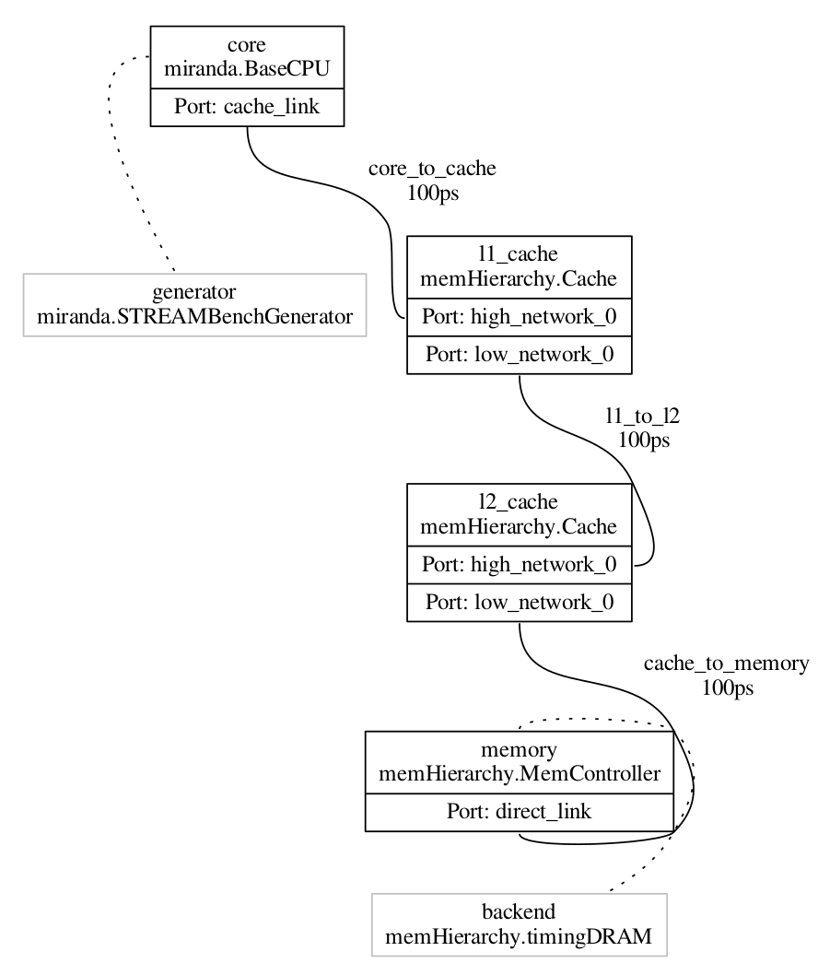
Viewing Configuration Graph
Let’s take a look at how SST views our system
Re-run demo_4 but add a command to dump the configuration graph
This gives you a GraphViz formatted file
Is this how you expected your system to look?
With this in mind, let’s add a second Miranda core…
$ sst --output-dot=graph_demo_4.dot demo_4.py
$ dot –Tpdf graph_demo_4.dot –o graph_demo_4.pdf
$ evince graph_demo_4.pdf

Slide 55
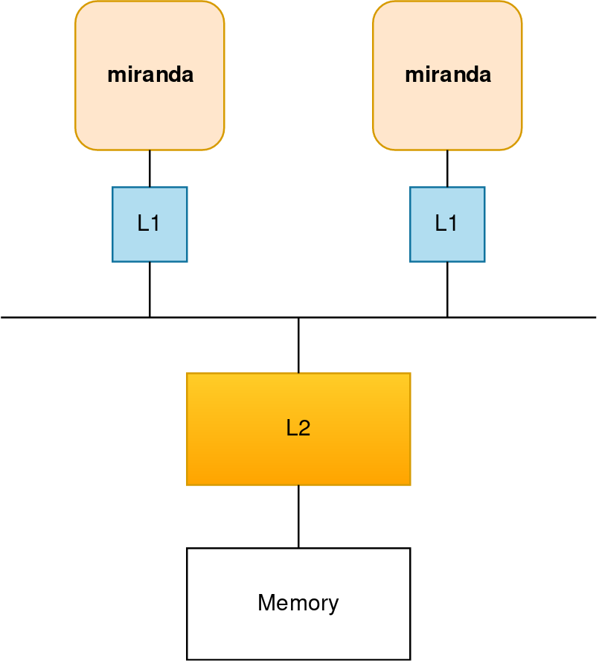
Running a Simulation – Add Components, Second Miranda
Copy configuration
Add an a second Miranda generator
What else might you need?
Dump the wiring diagram to verify the model
Launch simulation
$ cp demo_4.py demo_5.py
How about another L1 cache?
How are you going to wire everything together? How about a bus?
$ sst demo_5.py

Slide 56
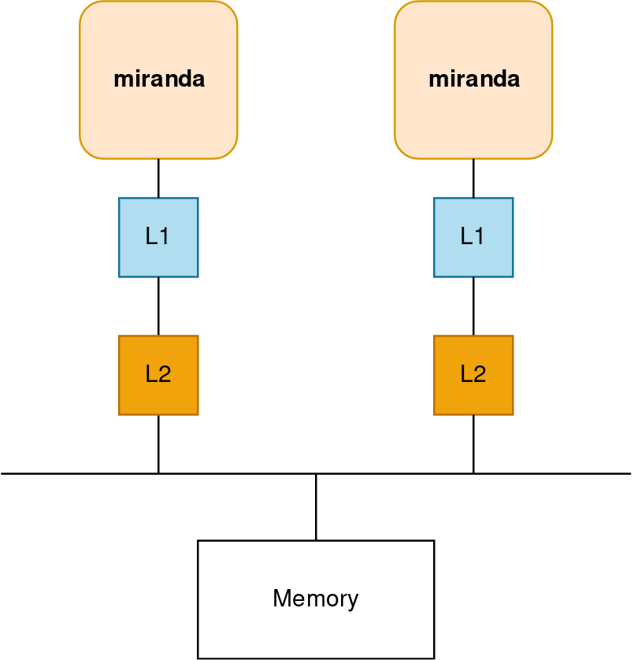
Running a Simulation – Add Components, Second L2
Copy configuration
Add L2 cache and move both above the bus
Launch simulation
$ cp demo_5.py demo_6.py
$ sst demo_6.py

Slide 57
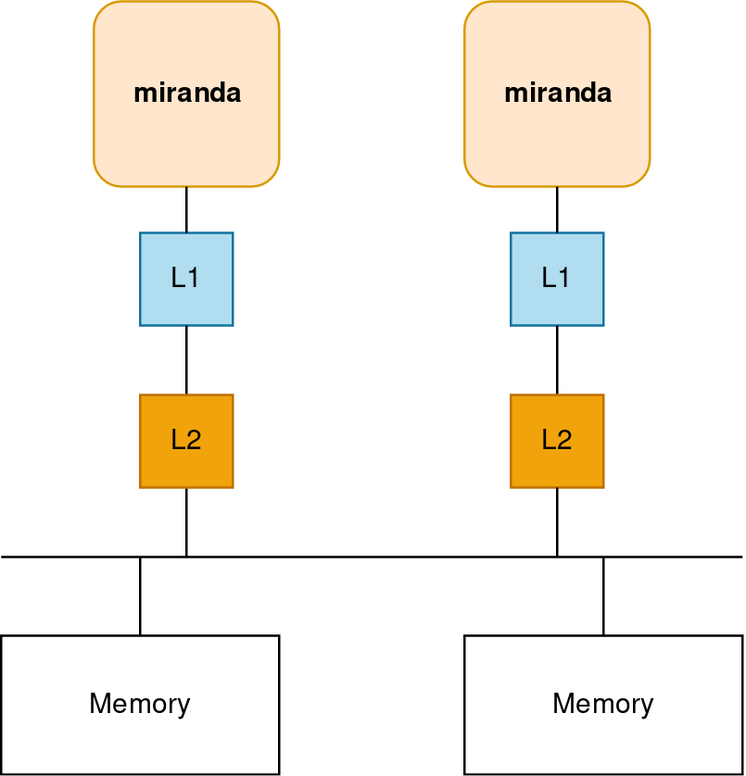
Running a Simulation – Add Components, Second Memory
Copy configuration
Add an a second L2 and memory controller
Think carefully about how addressing should will work…
Launch simulation
$ cp demo_6.py demo_7.py
Can you still use a bus?
Can the talk directly to the memory controller?
$ sst demo_7.py

Slide 58
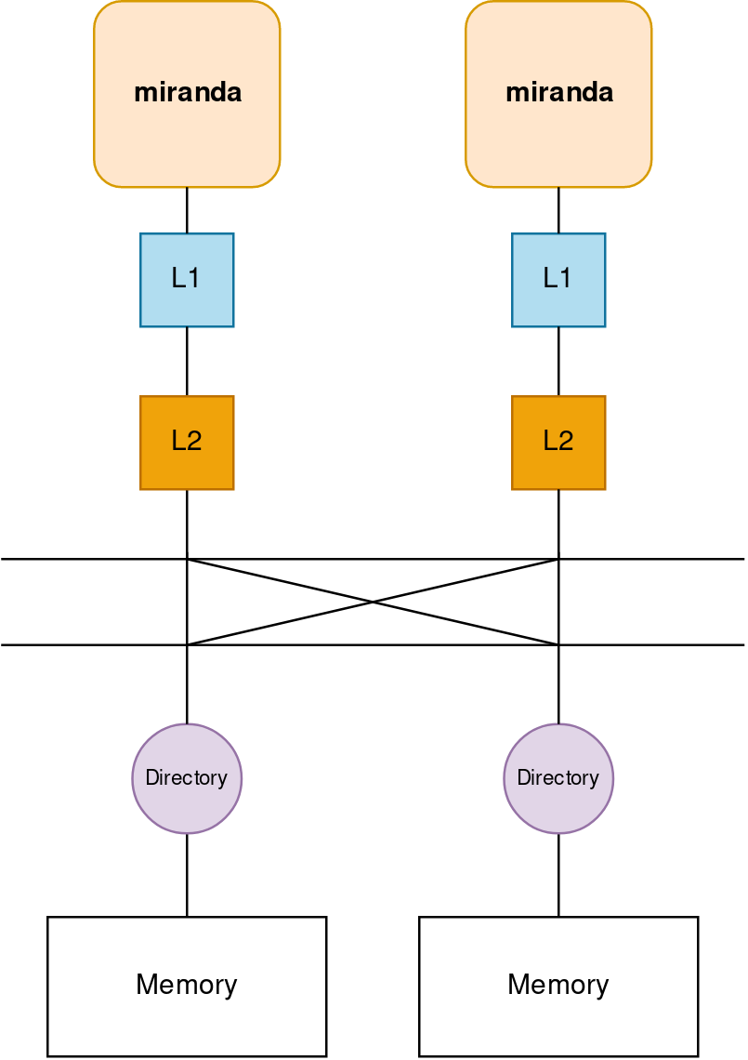
Running a Simulation – Add Components, Second Memory
Swap the bus component for the shogun component
Add directory controllers before the memory
shogun_xbar = sst.Component("shogunxbar", "shogun.ShogunXBar")
shogun_xbar.addParams({
"clock" : "1.0GHz",
"port_count" : 4,
"verbose" : 0
})
dirctrl = sst.Component("dirctrl_" + str(cache_id), "memHierarchy.DirectoryController")
dirctrl.addParams({
"coherence_protocol" : "MESI",
"entry_cache_size" : "32768",
"addr_range_end" : endAddr,
"addr_range_start" : startAddr,
"interleave_size" : "256B",
"interleave_step" : str(numLLC * 256) + "B",
})
dc_cpulink = dirctrl.setSubComponent("cpulink", "memHierarchy.MemNIC")
dc_memlink = dirctrl.setSubComponent("memlink", "memHierarchy.MemLink")
dc_cpulink.addParams({
"group" : 3,
})
dc_linkctrl = dc_cpulink.setSubComponent("linkcontrol", "shogun.ShogunNIC")

Slide 59
Getting help and extending SST

Slide 60
Extending SST
SST was designed for extensibility
Components/subcomponents can be added without touching SST Elements
Example: write a new prefetcher and have memH caches use it → no changes to memHierarchy
SST-Core APIs are stable → one year deprecation period
Element APIs may be less so but generally try to keep them consistent
Many users start with SST Elements and then build their own customized libraries
Partially or completely replacing SST Element functionality
Many approaches to using SST
Core only: Write your own components from scratch
Start from existing Elements and replace components/subcomponents to meet your needs
Wrap existing simulators and insert as components or subcomponents

Slide 61
Extending SST: Resources
Example element library
Components demonstrating links, ports, clocks, event handling, etc.
sst-elements/src/sst/elements/simpleElementExample/
simpleSimulation
Simulates a car wash (a little more complex than example elements)
Example external element library
Demonstrates building and registering a new element library
https://github.com/sstsimulator/sst-external-element
Website
Getting Started Extending SST (a little out of date)
Building Element Libraries outside SST source tree
Past tutorial material (under Downloads)
sst-simulator.org/SST-website API documentation

Slide 62
Finally: Getting help
SST wiki contains lots of information (www.sst-simulator.org)
Downloading, installing, and running SST
Element libraries and external components
Guides for extending SST
Information on APIs
Information about current development efforts
Past tutorial slides and exercises
SST Github
Current development
Issues track user questions as well as development plans, bugs, etc.

Slide 63
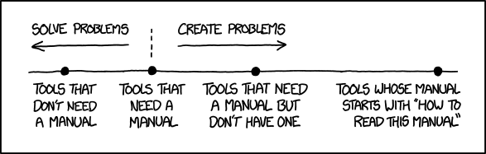
Part 1 wrap-up
SST is a parallel, flexible simulation framework
Can simulate many systems at many granularities
Capable of simulating modern architectures
Modular design for extensibility
Please keep us posted on your uses of SST as well as any capabilities you’ve added or would like to see added
The SST team wants to help you!
Documentation?
Examples?
Kittens?

Slide 64
GPGPU-Sim is next…

Slide 65
Backup

Slide 66
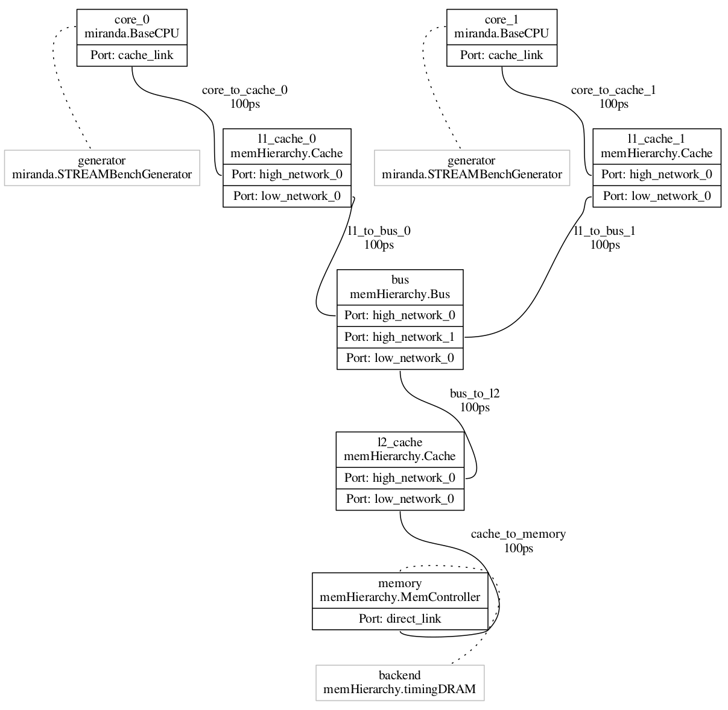
Demo_5 Wiring

Slide 68
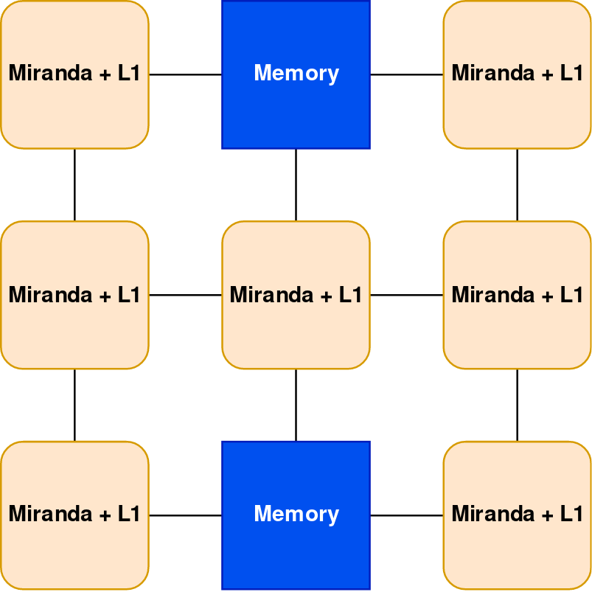
Running a Simulation – Add Components, Simple Node
Copy configuration
Add the components to create a simple node
Each PE has a Miranda generator and an L1
The two memory nodes should use timingDRAM
How should you connect everything?
Launch simulation
$ cp demo_6.py demo_7.py
$ sst demo_7.py

